Slide 1
Machine Learning Applications for Semiconductor Manufacturing Process Control
Enzo Borja
NYCDSA Capstone Project
January x, 2021
code: https://github.com/lorenzom21/capstone
Online article:

Slide 2
Overview
Introduction Semiconductor Process | Data Preparation cleaning exploration | Accelerating inspection Use the model to detect problems faster | Ad-hoc level process control Adjusting parameters to maximize yield | product uniformity How to make products more repeatable

Slide 3
Semiconductor process
deposition
lithography
etch
putting down material
"writing" the pattern"
etching the material based on pattern
Many other steps
These steps repeat for multiple layers.
Products are chips
i.e. CPU, GPU, LED’s

Slide 4
Traditional process control
Define limits.
Target the centerline.
If limits are exceeded, fail!
Example: deposition of a 500nm metal film
500 nm metal
495 nm
500 nm
505 nm
silicon substrate

Slide 5
Problems with traditional process control
Hundreds of parameters.
Interactions between parameters are not always comprehended.
Pass/fail may only be determined at end of line.

Slide 6
Three operations to clean the data
1. Drop columns with >15% NA
3. Drop 1 of each column that is highly correlated.
1.0
0.8
0.6
0.4
.02
0
2. Drop columns with only a single value.
Column 584
1
1
1
1

Slide 7
Building the Random Forest Model
Data: UCI SECOM Dataset
https://www.kaggle.com/paresh2047/uci-semcom#uci-secom.csv
538 factory parameters, and a pass/fail column
52 columns omitted for having >15% n/a
Actual yield: 92%
Highly imbalanced data means basic Random Forest will not be meaningful!

Slide 8
Optimizing the Random Forest Model
Must use BalancedRandomForest
A blanket “pass” classification would yield 92% accuracy.
Tried N trees from 100 to 1000. More is just better.
train score: 79%
test score: 74%
 | fail | pass
precision | 16% | 96%
recall | 58% | 76%

Slide 9
How can we use the model?
Acceleration inspection and data feedback.
Optimize parameters at each station.

Slide 10
Acceleration inspection and data feedback
slower data feedback
Main process
model classification
general inspection
pass/fail decision
8% are true fails
pass
fail
slower, long queue
16% are true fails
faster data feedback
close inspection
faster, small queue
pass/fail decision

Slide 11
Optimize parameters at each station
method | complexity | Usefulness
Skewing distribution of a single parameter | low | low
Controlling a parameter based on upstream data and assumptions about downstream data | high | high

Slide 12
Skewing distribution of a single parameter
Not very meaningful except at extremes.
Parameter 59 was selected.
Each value was skewed +/- x*(standard deviation)
Centering around the actual mean may already be the best.

Slide 13
Optimizing a single lot
Known data of upstream values
What is the target for parameter 59?
Assume mean values for downstream parameters.
skew | pass/fail
-8.07 | pass
-3.98 | pass
0.12 | pass
4.21 | pass
8.3 (base) | fail
12.39 | fail
16.49 | fail
20.58 | fail
24.67 | fail
In this example lot:
parameter 59 actual value: 8.3
parameter 59 mean: 2.9
This lot is predicted to fail!
Repeat at each station and evaluate:
Can this lot be saved or should it be scrapped early?

Slide 14
Using K-means clustering to tighten product variability
Tried clustering for 1 to 9 clusters. Elbow is between 2 and 3. Used 2 for further analysis.
Are the 2 clusters based on on pass/fail?

Slide 15
Using K-means clustering to improve product variability
Difference is not based on pass/fail
We must find and eliminate difference between these two clusters. A good process has no clustering.
Cluster | Passing rate | N
0 | 92.8% | 1,245
1 | 93.5% | 322

Slide 16
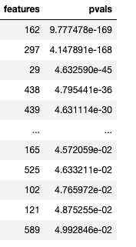
Finding the difference between clusters
100 parameters with p-value < 0.05
Use Kruskal test to compare parameters between two clusters. This test is similar to ANOVA or t-test but can tolerate difference in size of the two samples.
Rank parameters based on the biggest difference (i.e. smallest p-values.)

Slide 17
Finding the difference between clusters
Biggest mismatch was parameter 162. A factory manager would prioritize understanding and controlling this mis match.

Slide 18
Conclusion
These methods cannot replace traditional methods of semiconductor process control, but they could be the winning cutting edge. The models can be used to
Accelerate inspection.
Improve control at the station level.
Reduce product variability.

Slide 19
Backup

Slide 20
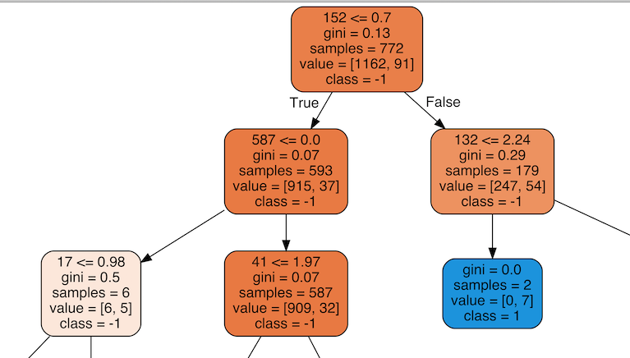
Visualization of one tree
If you are controlling parameter 152, do you want it less than or greater than 0.7? Following options:
Controllability: Decide based on what has simpler branching down stream.
Best chances: Decide based on which has the highest probability of success.

Slide 21
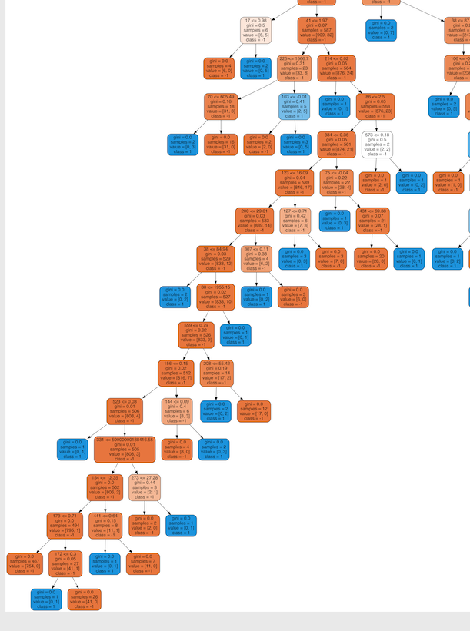
Prioritizing controllability
If you were this guy, which path would you take?
simple
Complicated

Slide 22
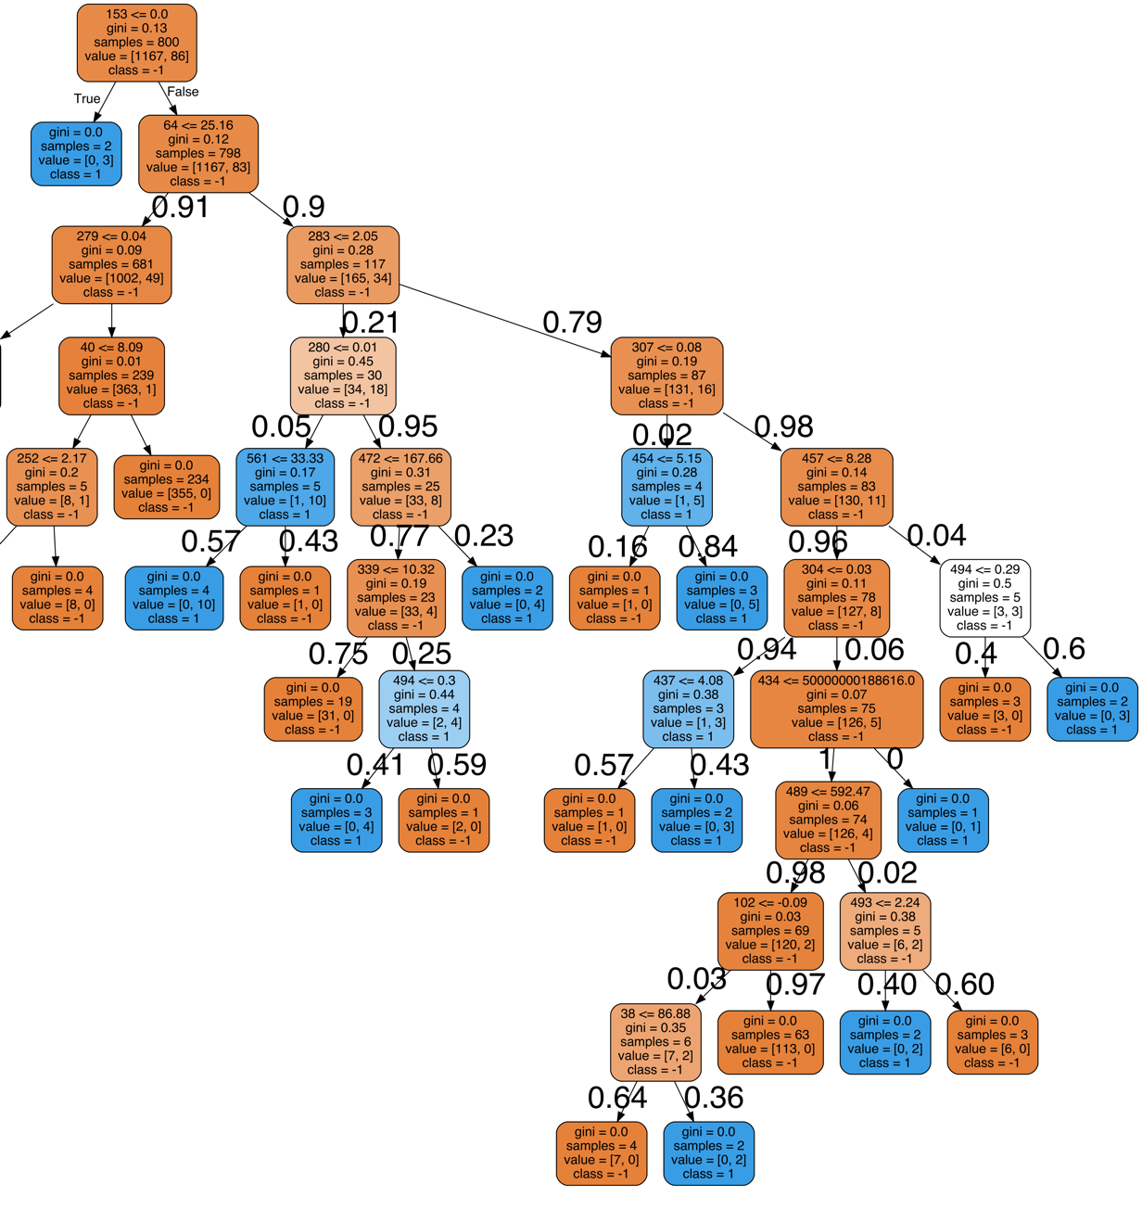
Prioritizing best chance of success
module making decision
Assume we are the module controlling parameter 283.
Do we keep it above or below 2.05?
outcome | chance of passing
below | 84.9%
above | 45%
0.029
0.024
0.046
0.046
0.017
0.55
0.016
0.024
This parameter is already 79% likely to be >2.05, which is not favorable!
These was done by:
Calculate the probabilities at each split based on the distribution of data at that node.
Multiply all the probabilities leading to an endpoint to get the probability of that endpoint.
Sum all the probabilities of the passing outcomes for below and above.
0.076
0.110
0.51
0.51
0
if param 283 <=2.05
0.054
0.005
0.005
0.001
0.0006
if param 283 > 2.05

Slide 23
Challenge for Implementing Random Forest
This is just 1 tree. How to aggregate predictions of all 100 trees?
Brute force method: do analysis shown before for each tree, and take average. This is can be computationally expensive, or a very painful manual process.

